Slide 1

Deployment of Article CMS

Slide 2

What is cloud computing?
Cloud computing is renting resources, like storage space or CPU cycles, on another company's computers. You only pay for what you use. The company providing these services is referred to as a cloud provider. Some example providers are Microsoft, Amazon, IBM and Google.

Slide 3
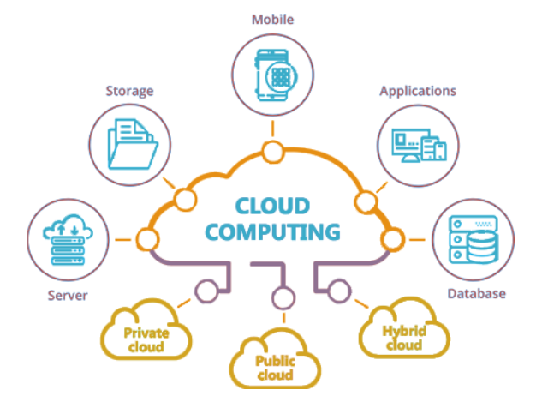
Responsibilities of Cloud Provider
The cloud provider is responsible for the physical hardware required to execute your work, and for keeping it up-to-date. The computing services offered tend to vary by cloud provider. However, typically they include Compute power, Storage, Networking, and Analytics.

Slide 4
Benefits of cloud computing?
Its Cost Effective
Its Scalable
Its Elastic
Its reliable
Its global
Its secure

Slide 5
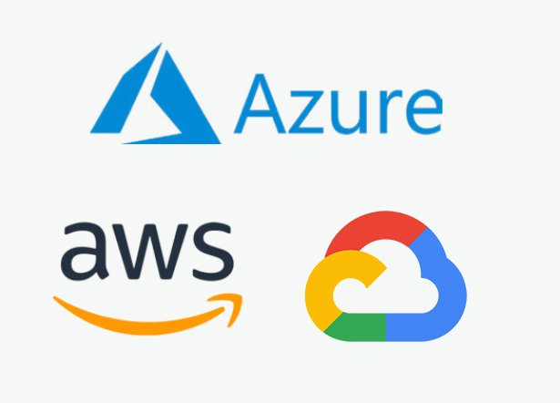
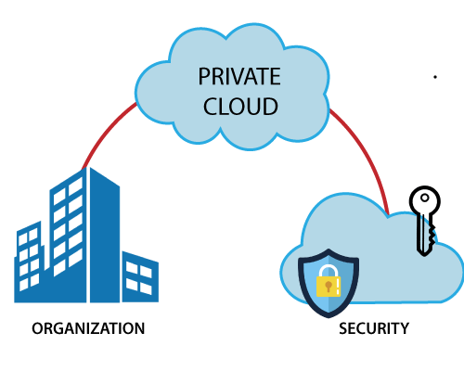
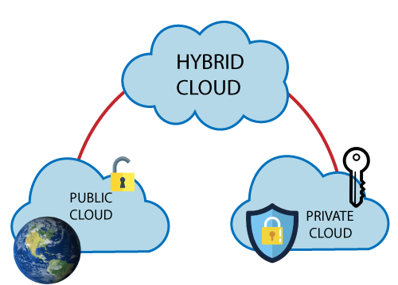
Types of cloud development models
Public Cloud
Private Cloud
Hybrid Cloud

Slide 6
Types of cloud Services offered by Azure
Infrastructure as a Service
Platform as a Service
Software as a Service

Slide 7

What is Microsoft Azure
Microsoft Azure is a is a public cloud computing platform—with solutions including Infrastructure as a Service (IaaS), Platform as a Service (PaaS), and Software as a Service (SaaS) that can be used for services such as analytics, virtual computing, storage, networking, and much more. It can be used to replace or supplement our on-premise servers.

Slide 8
Tools and Environments Used for the Project
Azure Portal
Azure App Service
GitHub
Azure SQL Data Base
Azure Active Directory

Slide 9
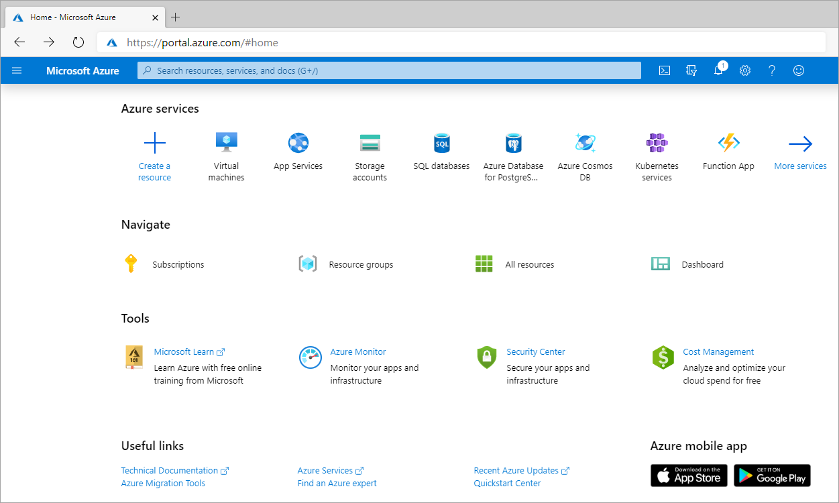
The Azure Portal
The Azure portal is a public website that you can access with any web browser. The dashboard view provides high-level details about your Azure environment. You can customize the dashboard by moving and resizing tiles and displaying services you're interested in. The portal doesn't provide any way to automate repetitive tasks. For example, to set up multiple VMs, you would need to create them one at a time by completing the wizard for each VM. This process makes the portal approach time-consuming and error-prone for complex tasks.

Slide 10
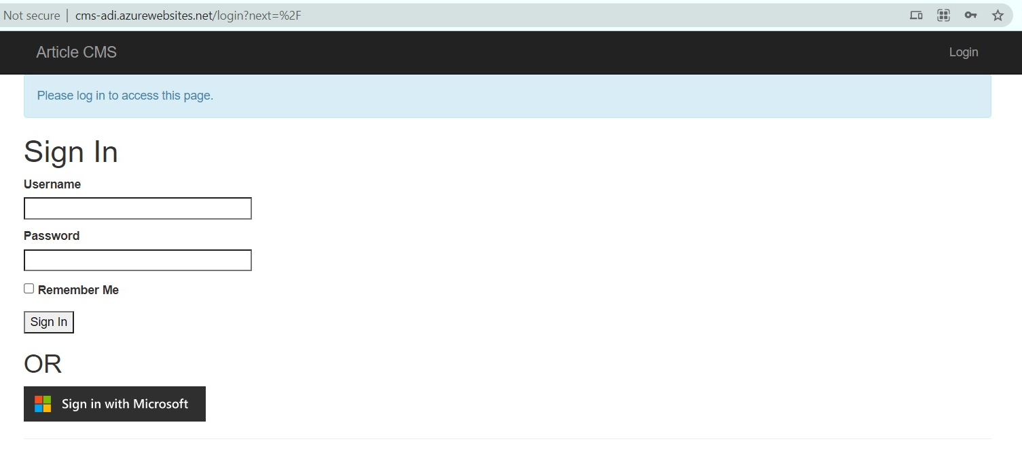
What is Article CMS ?
In this project, I was given a simple Content Management System (CMS) for articles, where a user can log in, view published articles, and publish new articles.

Slide 11
Purpose of the Project
Here, I was in charge of creating and managing the resources necessary to fully deploy both the necessary storage and compute resources for the app to Azure. As part of the project, I have also analyzed which resource best fits for app deployment between a VM or App Service. Lastly, I have added in an authentication option to Sign in with Microsoft, as well as logging for successful and unsuccessful logins as shown in further screenshots.

Slide 12

Parts of the projects
Application Home Page
Invalid Login
Successful Login
Post Edit
Create New Post
Resource Group
App service
App service plan
SQL Database
Storage account

Slide 13
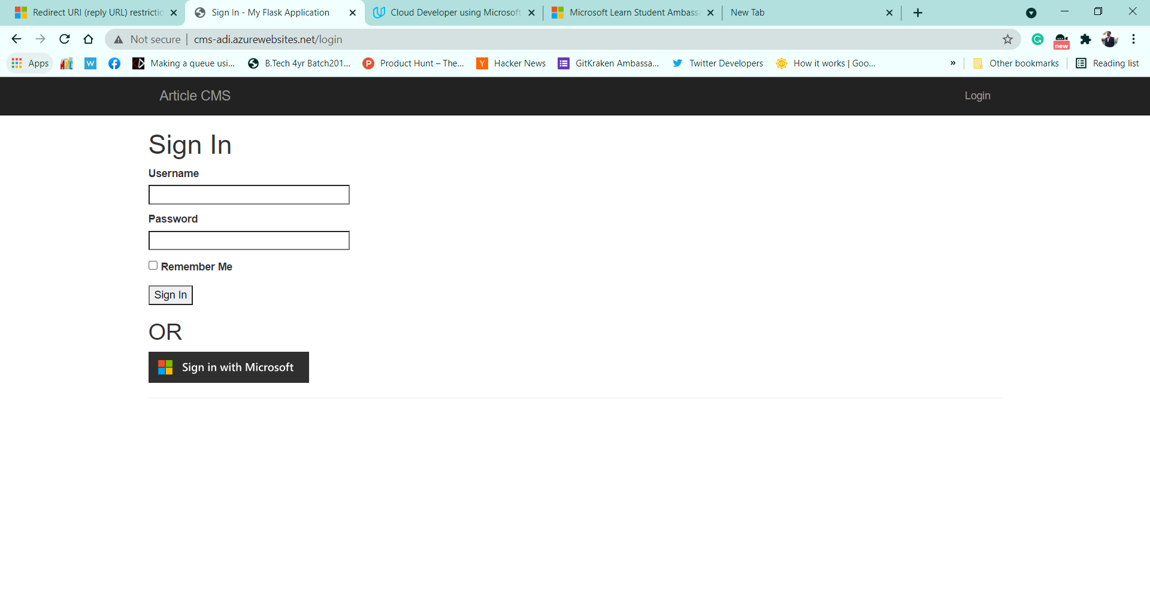
Home page

Slide 14
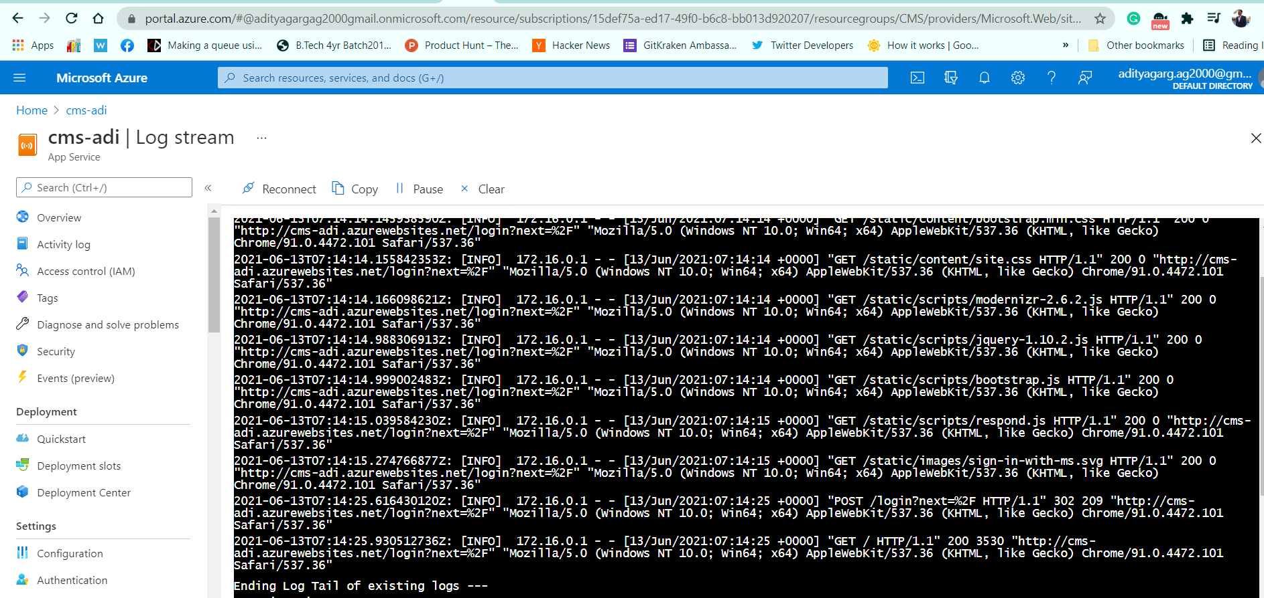
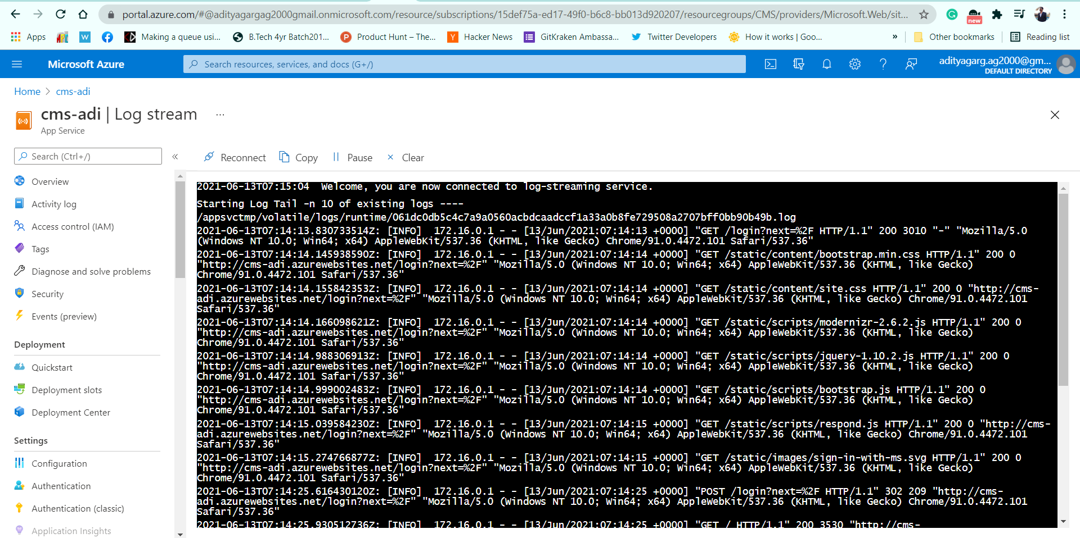
Logs for Successful login

Slide 15
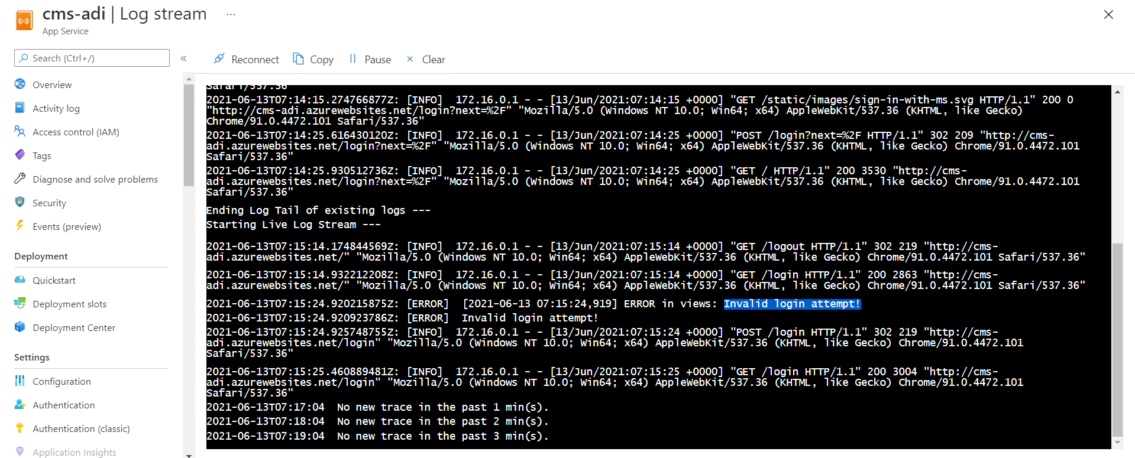
Logs for unsuccessful attempt

Slide 16
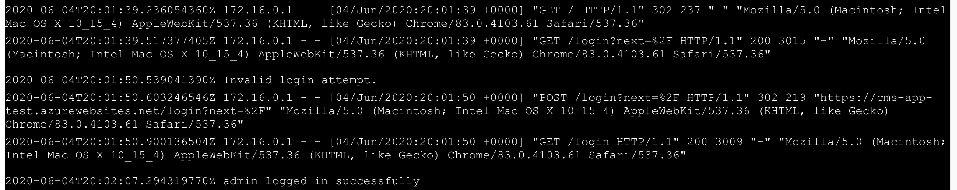
Logs in Command Line Interface

Slide 17
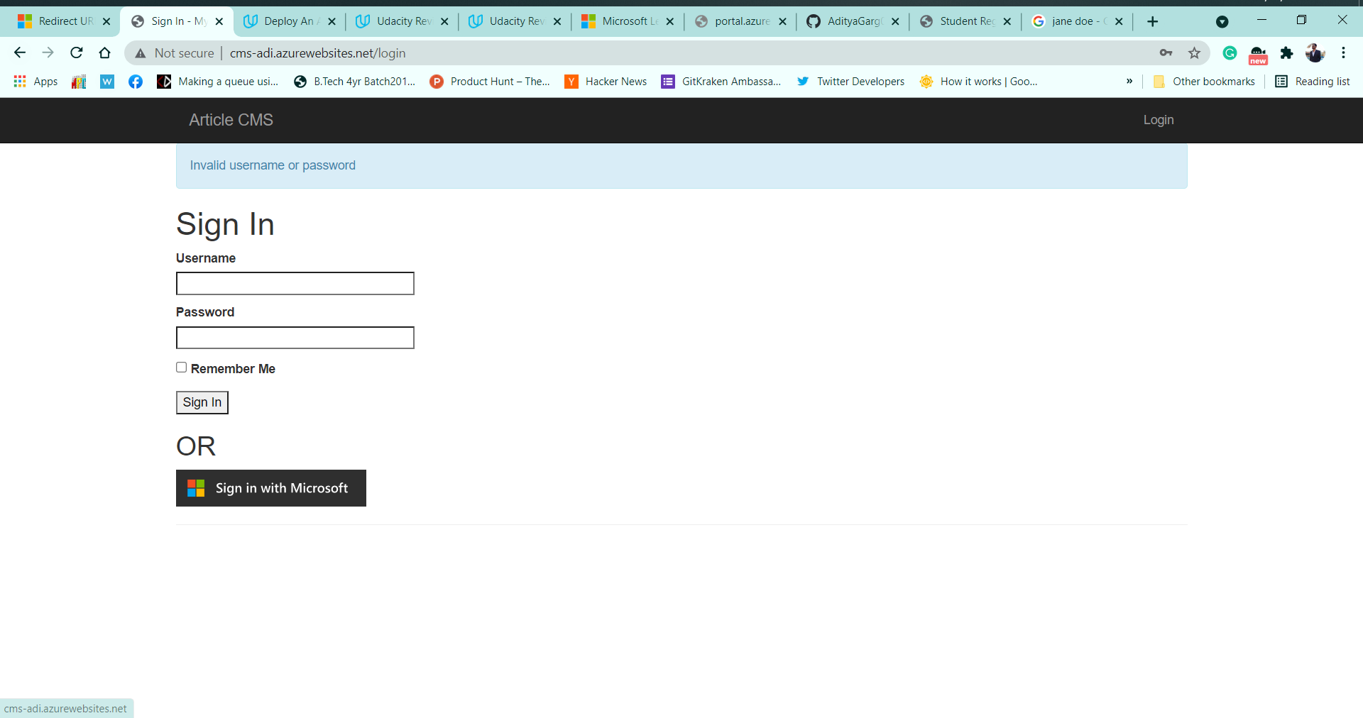
Unsuccessful login

Slide 18
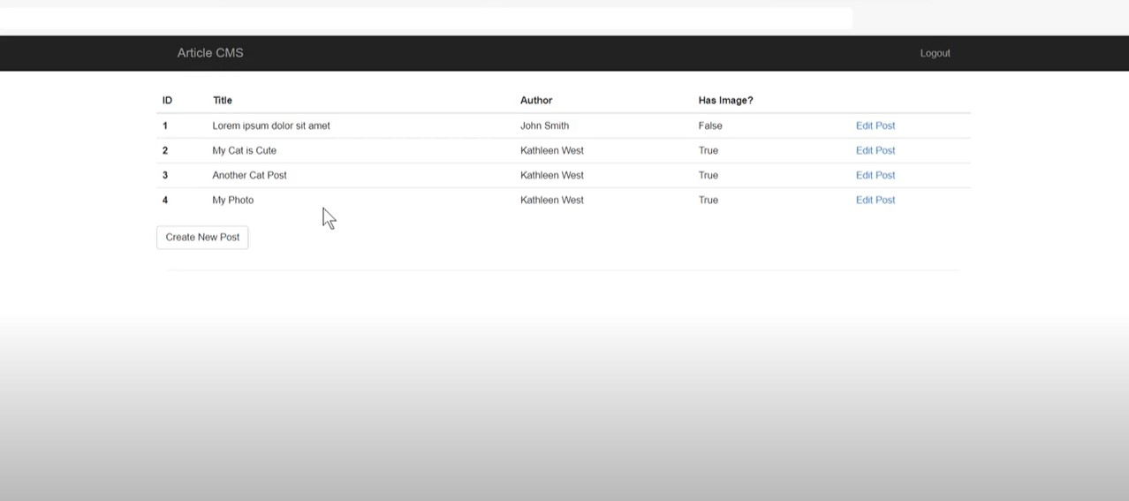
Home page after successful login

Slide 19
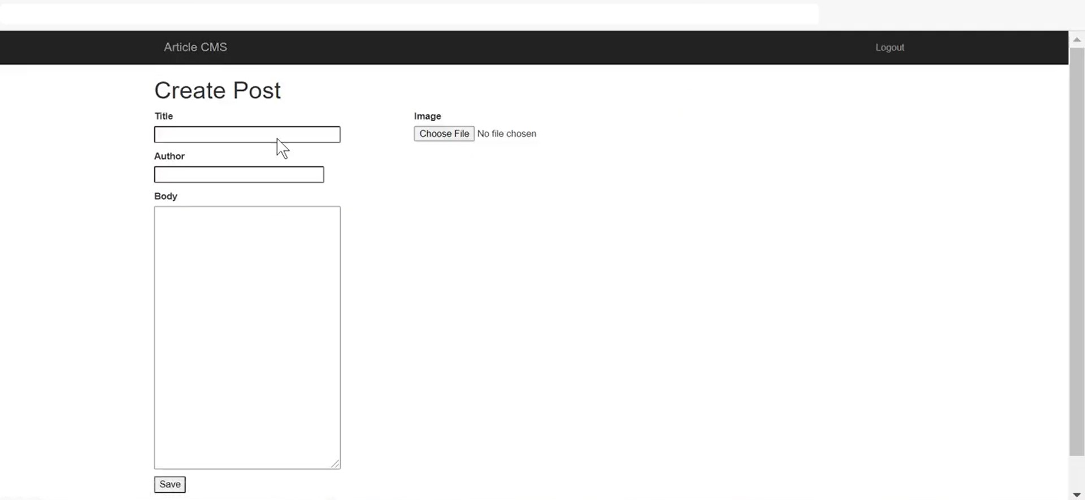
Create Post After Successful login

Slide 20
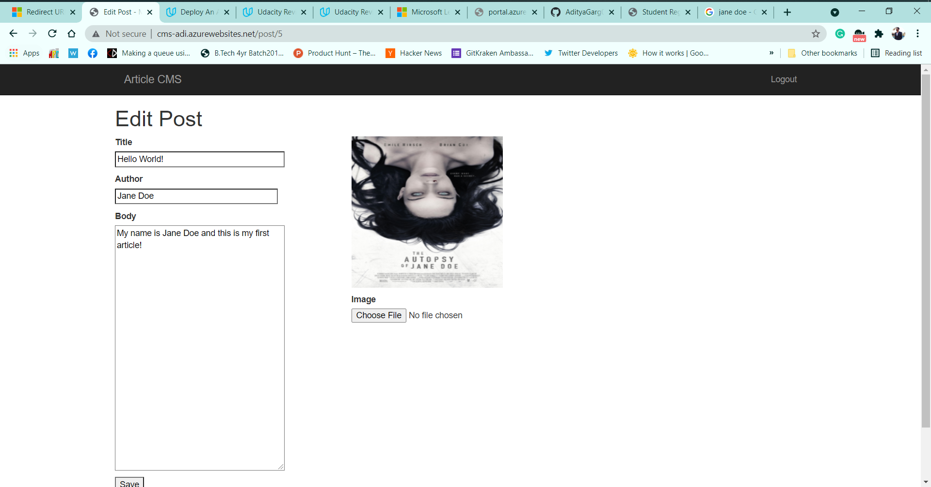
Edit Post after login

Slide 21
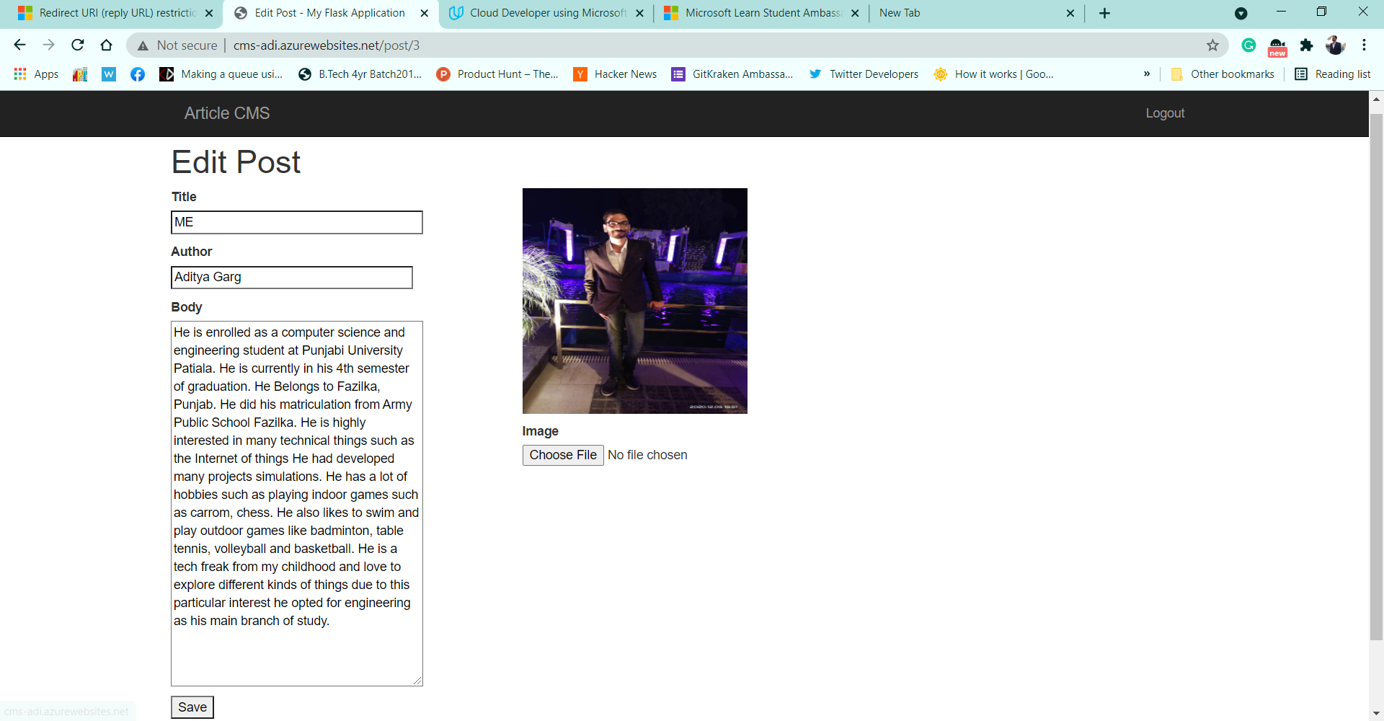
Editing created post

Slide 22
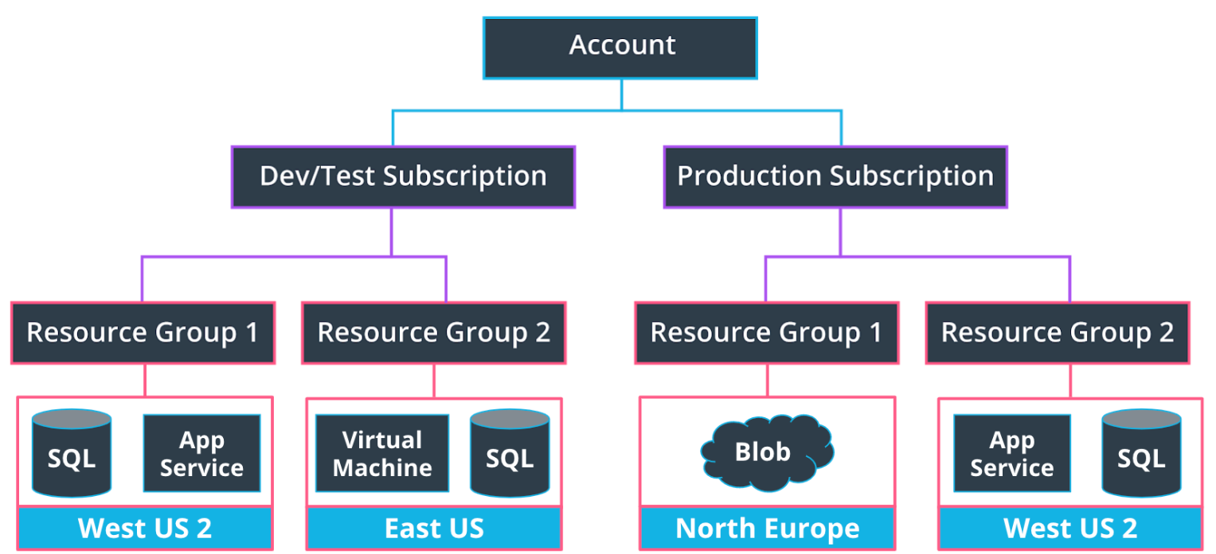
Resource Group
These help to organize resources we use, such as Virtual Machines, App Services, storage options and other resources in order to make resource management easier. We may have a resource group for a specific project, or because resource groups are tied to a Region, we may have resource groups containing similar resources in multiple locations across the world. A region contains at least one data center but could have multiple data centers that are close by and networked together through a low-latency network. There are over 60 regions available worldwide and available in 140 countries, such as Central India, East US and Japan West.

Slide 23
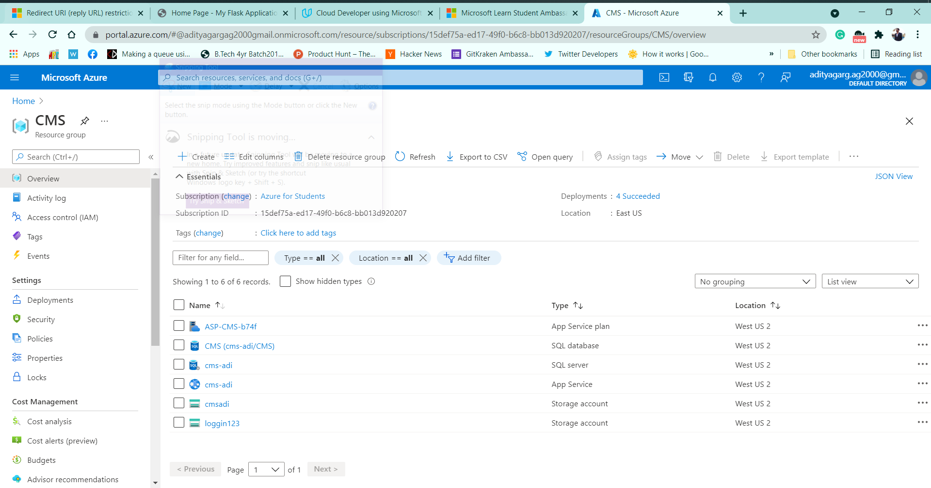
Resource Group of Article CMS

Slide 24
App service
App Service is a platform as a service (PaaS) offering. This also enables us to build and host web apps, background jobs, mobile back-ends, and RESTful APIs in the programming language of our choice without managing infrastructure. It offers automatic scaling and high availability. Azure App Service supports Windows and Linux and enables automated deployments from GitHub, Azure DevOps, or any Git repo to support a continuous deployment model. This platform as a service (PaaS) environment allows us to focus on the website and API logic while Azure handles the infrastructure to run and scale our web applications.

Slide 25
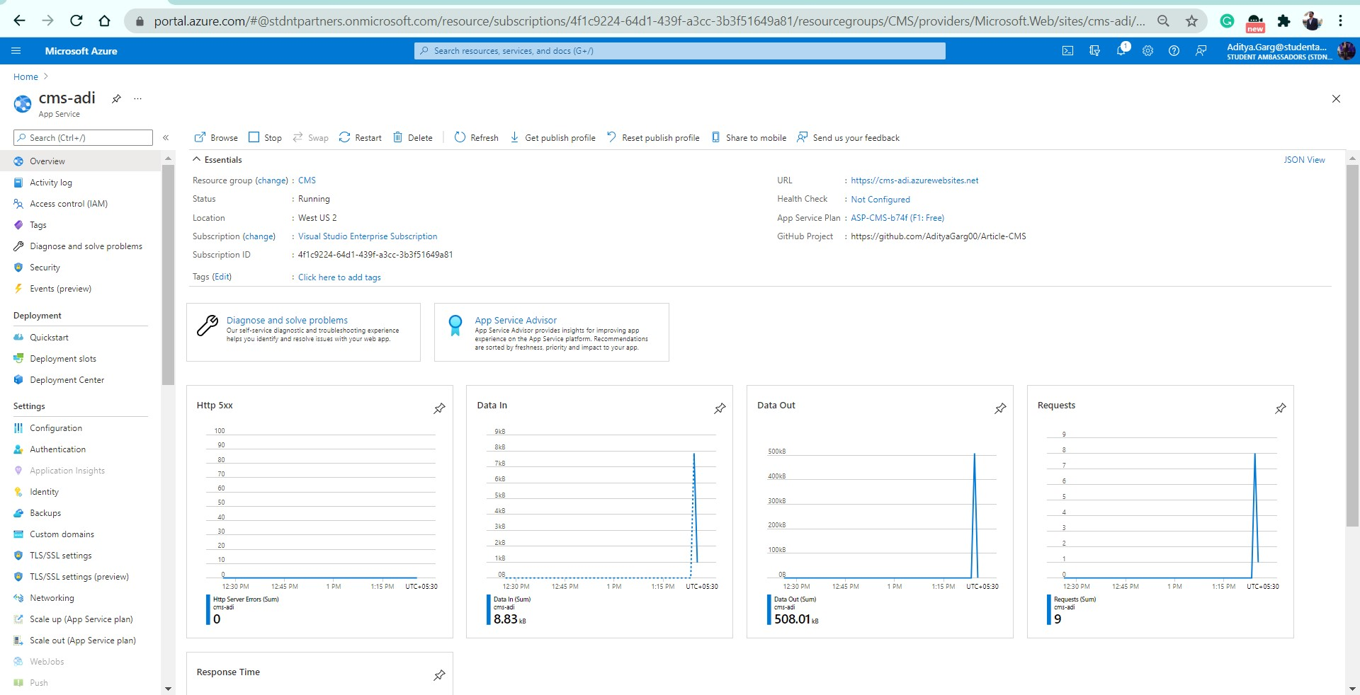
App Service For Article CMS

Slide 26
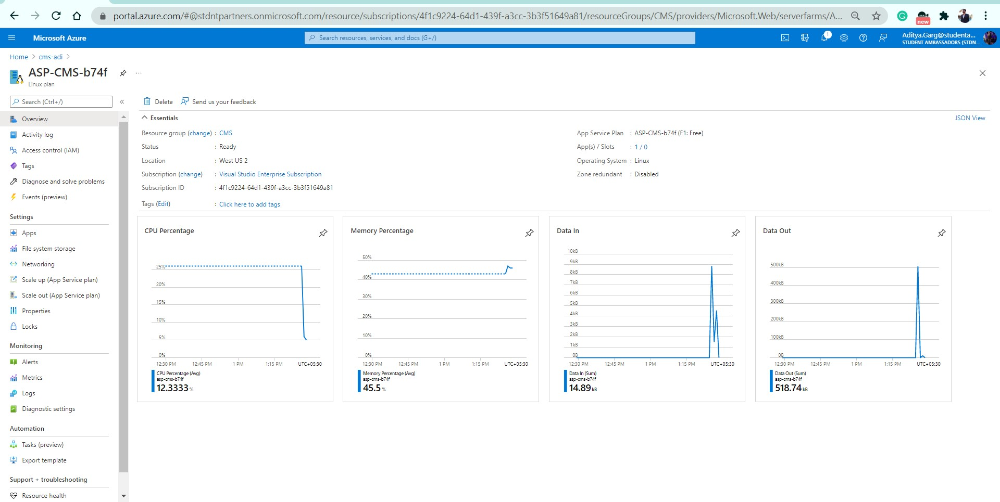
App service plan

Slide 27

Azure Storage
An Azure storage account can store data objects you create, such as blobs and files. This storage account provides a unique namespace in Azure for your data, and every item that you store has an address that includes your unique account name. It’s worth noting the name of the storage account can contain only lowercase letters and numbers. In this project, I have mostly utilize General-purpose v2 storage accounts, which provide support and the latest features for Azure Storage services such as blobs, Files, Disks, Queues, and Tables. This type of storage account is recommended for most scenarios when using Azure Storage services

Slide 28
SQL Database
Azure SQL databases are used for structured, relational data. In Azure, we also need to first create a related SQL server to hold the database, although we can create multiple SQL databases under a single SQL server. The SQL Server and Databases deployed by me are shown in further screenshots.

Slide 29
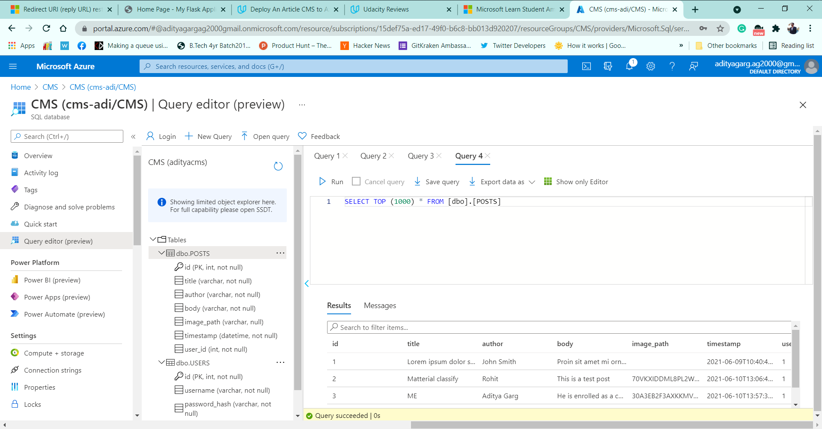
SQL Database Querying Data

Slide 30
Blob Storage
A Binary Large Object or Blob is a data type that can store unstructured (binary) data and is used to store things like images or videos in a database. Blobs are not the go-to choice when it comes to structured data that is queried frequently, such as user profile information. They have higher latency than memory and local disk and don't have the indexing features that make databases efficient at running queries.

Slide 31
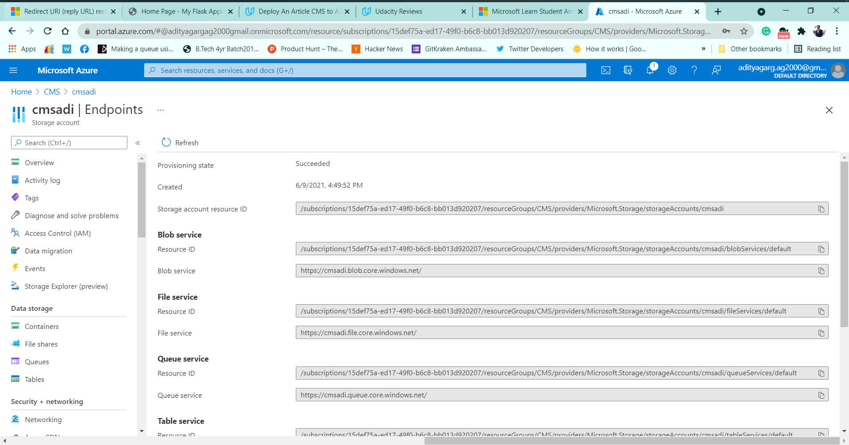
Working Blob Storage

Slide 32
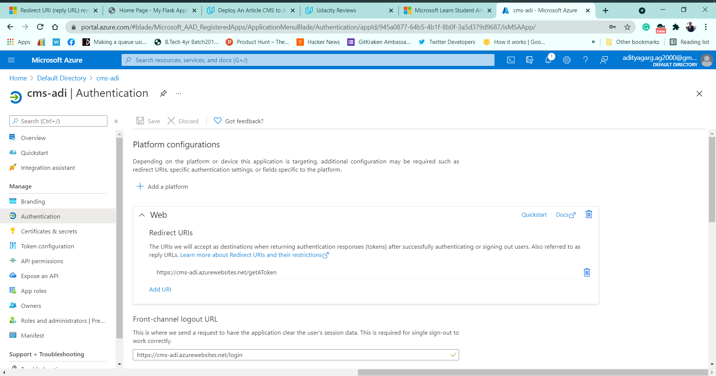
Security and Monitering

Slide 33
Skills Learnt while deploying the project
Creating and deploying virtual machines and app services
Setting up cloud storage services, such as Azure SQL Databases and Blob Storage, and connecting them to an app
Adding OAuth 2.0 capabilities with the Microsoft Authentication Library and Azure Active Directory to your app
Implementing monitoring and logging solution

Slide 34
About me

Slide 35

Thank you for your time

